Slide 1
WEB PROJECT
PROPOSAL
Here is where your presentation begins

Slide 2
TABLE OF CONTENTS
01
04
About the Project
Sneak Peek
02
05
Major Requirements
Project Stages
03
06
Project Goals
Our Team
A Full-stack IoT website
Tools and Techs
Reliability

Slide 3
ABOUT THE PROJECT
Developed a full-stack IoT website that displays records and graphs as per sensor readings.

Slide 4
TOOLS AND TECHNOLOGIES

Slide 5
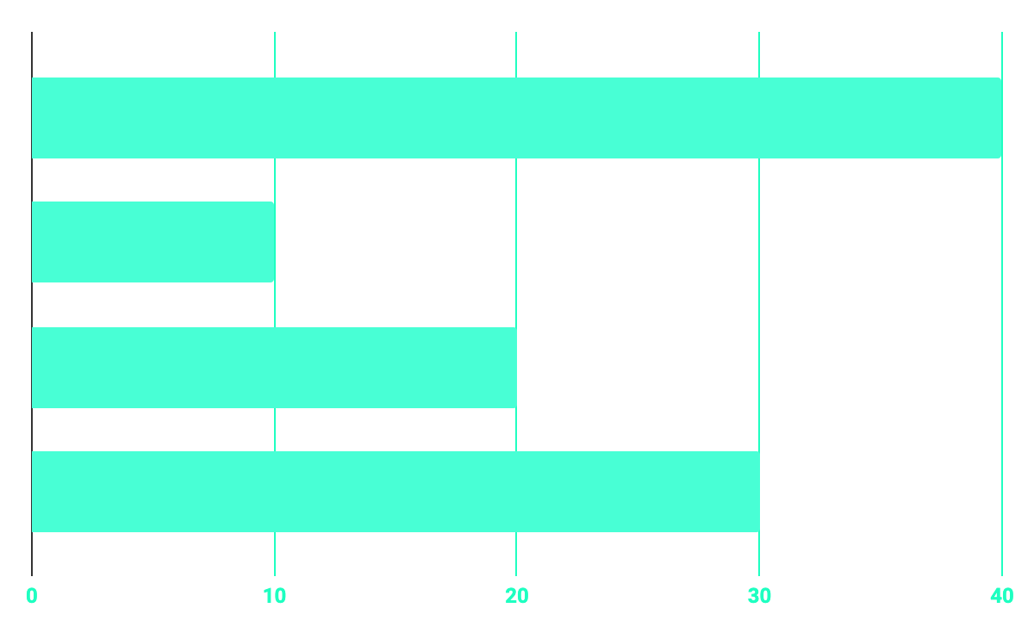
BUDGET
40%
20%
PROGRAMMING
10%
30%
DATABASE
WEB DESIGN
UX RESEARCH

Slide 6
OUR GOALS
SECURE
ACCESSIBLE
FAST, RELIABLE AND RESPINSIVE
Authentication is required
Across the world

Slide 7
SNEAK PEEK
HEADER
TEXT
SLIDER
ICONS

Slide 8
A VIDEO IS A GOOD IDEA
Insert your multimedia content here

Slide 9

PROJECT STAGES
STEP 2
STEP 1
STEP 3
Development
Exploration
Testing

Slide 10
OUR TIMELINE
WEEK 1, 2
WEEK 5
WEEK 3, 4
WEEK 6, 7
Explored ESP32 Module
Testing
Developed Webpage
Improved functionality and created PPT

Slide 11
THE TEAM
JENNA DOE
JOHN DOE
JIMMY DOE
You can replace the image on the screen with your own
You can replace the image on the screen with your own
You can replace the image on the screen with your own

Slide 12
THANKS!

Slide 13
CREDITS
Presentation template by Slidesgo
Icons by Flaticon

Slide 14
OUR COMPANY
GOSTUDIO
Mercury is the closest planet to the Sun and the smallest one in the Solar System—it’s only a bit larger than our Moon. The planet’s name has nothing to do with the liquid metal since it was
named after the Roman messenger god, Mercury.

Slide 15
RESOURCES
Did you like the resources on this template? Get them for free at our other websites.
PHOTOS
Young businessman with hands in his pocket talking on mobile phone
Smiling ethnic woman with gray laptop
Smiling young man busy in texting message to someone
VECTORS
Flat computer engineering concept
Circuit of user experience
Timeline infographic
Logotype collection
Flat social media multimedia player templa
Gradient technology logo template collection
Digital marketing landing page template
Colorful responsive landing page
Modern web design concept with hand drawn style
App development concept with flat design

Slide 16
Fonts & colors used
This presentation has been made using the following fonts:
Roboto
(https://fonts.google.com/specimen/Roboto+bold)
Roboto
(https://fonts.google.com/specimen/Roboto+Thin)
#48ffd5
#0e2a47
#ffffff

Slide 18
...and our sets of editable icons
You can resize these icons without losing quality.
You can change the stroke and fill color; just select the icon and click on the paint bucket/pen.
In Google Slides, you can also use Flaticon’s extension, allowing you to customize and add even more icons.

Slide 19
Educational Icons
Medical Icons

Slide 20
Business Icons
Teamwork Icons

Slide 21
Help & Support Icons
Avatar Icons

Slide 22
Creative Process Icons
Performing Arts Icons

Slide 23
Nature Icons

Slide 24
SEO & Marketing Icons

